Slide 1
Tech procedures

Slide 2
Need a loaner for the day?
BRING. YOUR. DEVICE. TO. SCHOOL. EVERY. DAY.
We have a VERY limited number of loaners so they are first come/first served.
Get a Technology pass in Teachers.io from your extension/intervention teacher. You MUST have a pass.
Come to the library before 9:45.
Return the device to Ms. Neal at 3:55.
No pass? After 9:45? We’re all out of devices? No loaner! Return to class and work with pencil & paper.

Slide 3
Having device issues?
BRING. YOUR. DEVICE. TO. SCHOOL. EVERY. DAY.
Get a Technology pass in Teachers.io from your extension/intervention teacher. You MUST have a pass.
Bring your device to the library before 9:45.
No pass? After 9:45? Return to class and work with pencil & paper.

Slide 4
Charger not working?
BRING. YOUR. DEVICE. TO. SCHOOL. EVERY. DAY.
Get a Technology pass in Teachers.io from your extension/intervention teacher. You MUST have a pass.
Bring your charger to the library before 9:45.
To get a new charger, you MUST return the non-working charger.
No pass? No charger to swap? After 9:45? No new charger. Return to class and work with pencil & paper.

Slide 5
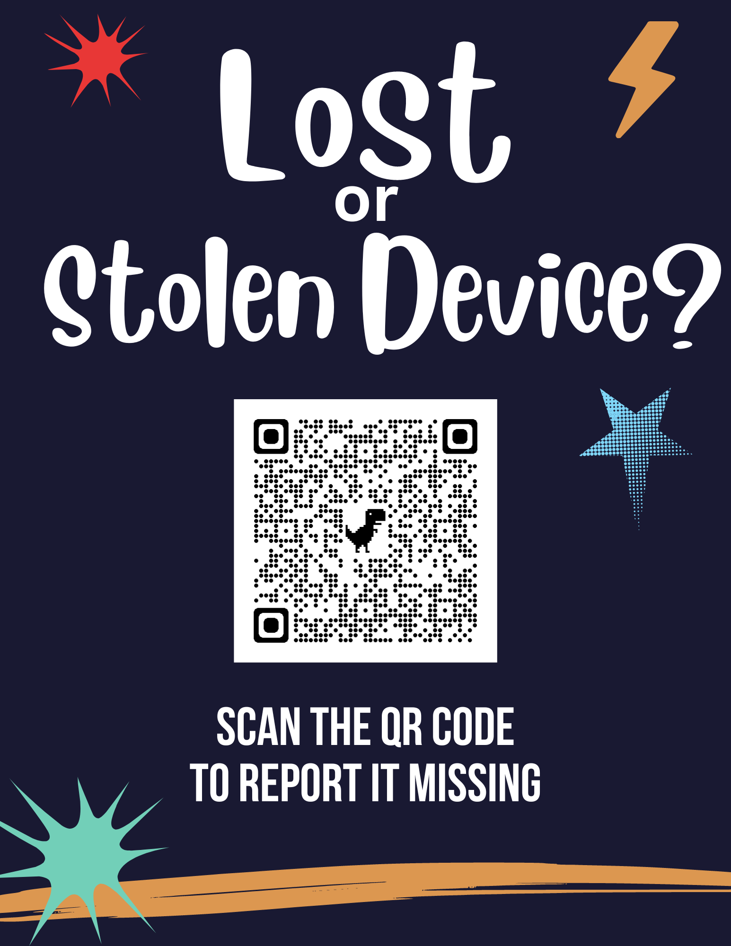
Lost your computer?
BRING. YOUR. DEVICE. TO. SCHOOL. EVERY. DAY.
We do not have loaners for lost devices. You will need to report your device lost and work with pen & paper until a staff member follows up with you.
This form is also in the library GCR.
https://forms.gle/oxCrZUimL9mY3dHj8

